Slide 1
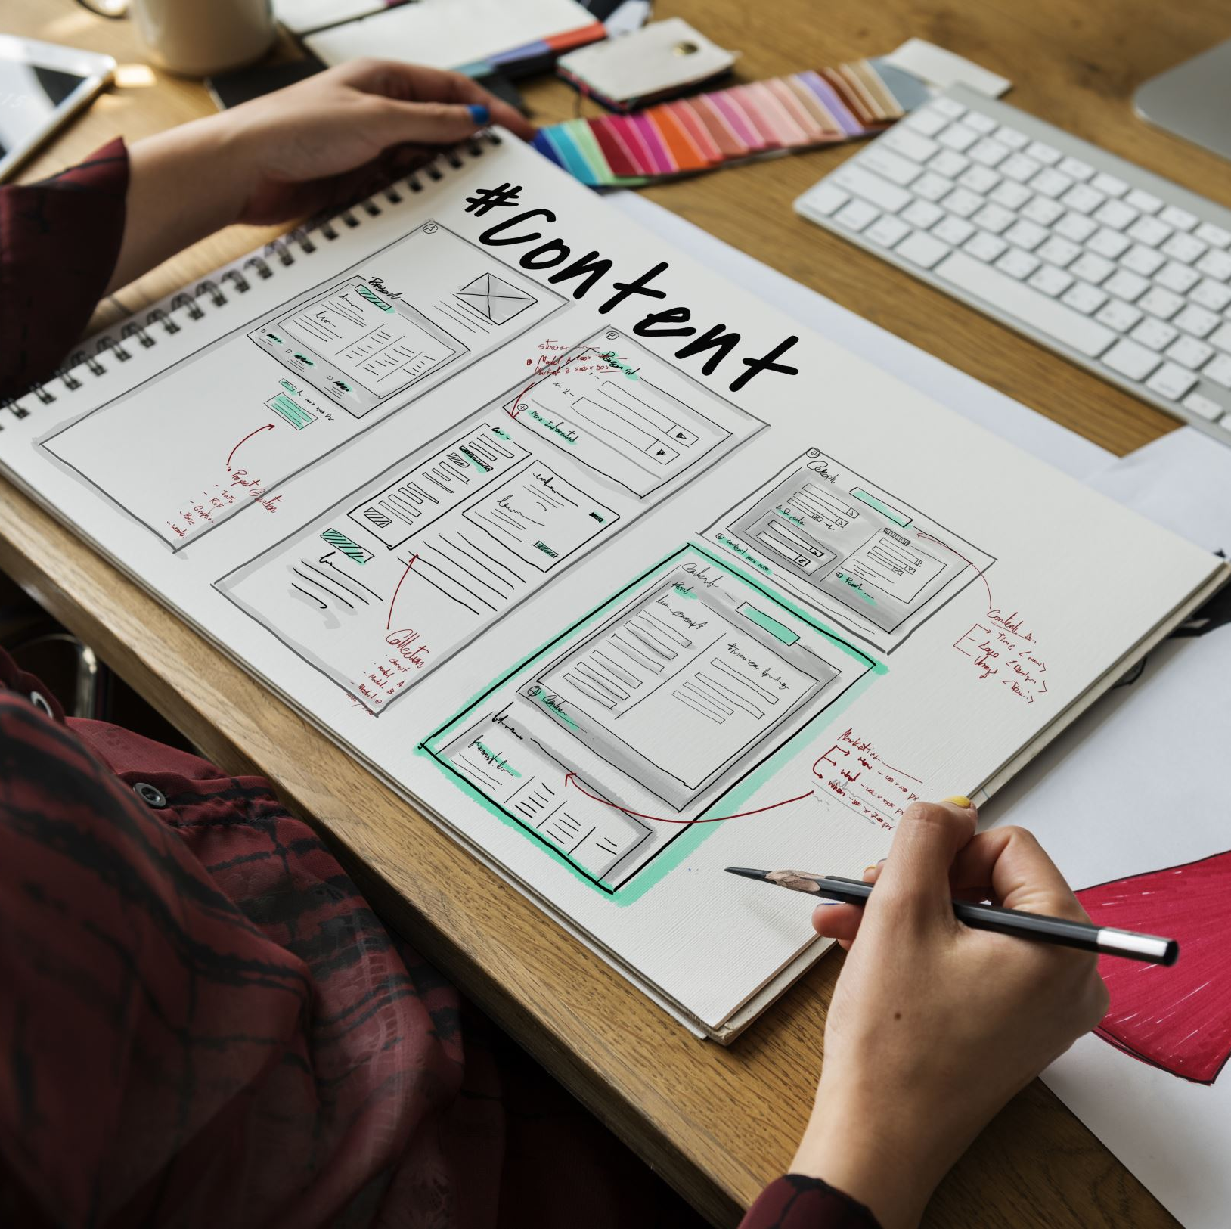
Comparison of Software Development Models
SER 416 – Assignment 1
Waterfall, Spiral, RUP, Agile
Bhupinder Singh
Course: SER 416
October 16th, 2025
Notes:
Hi, my name is Bhupinder Singh.
Out of the four software development models we studied in this assignment — Waterfall, Spiral, RUP, and Agile — I chose to make my video presentation on Agile.
software development model.

Slide 2
Model 4: Agile

Slide 3
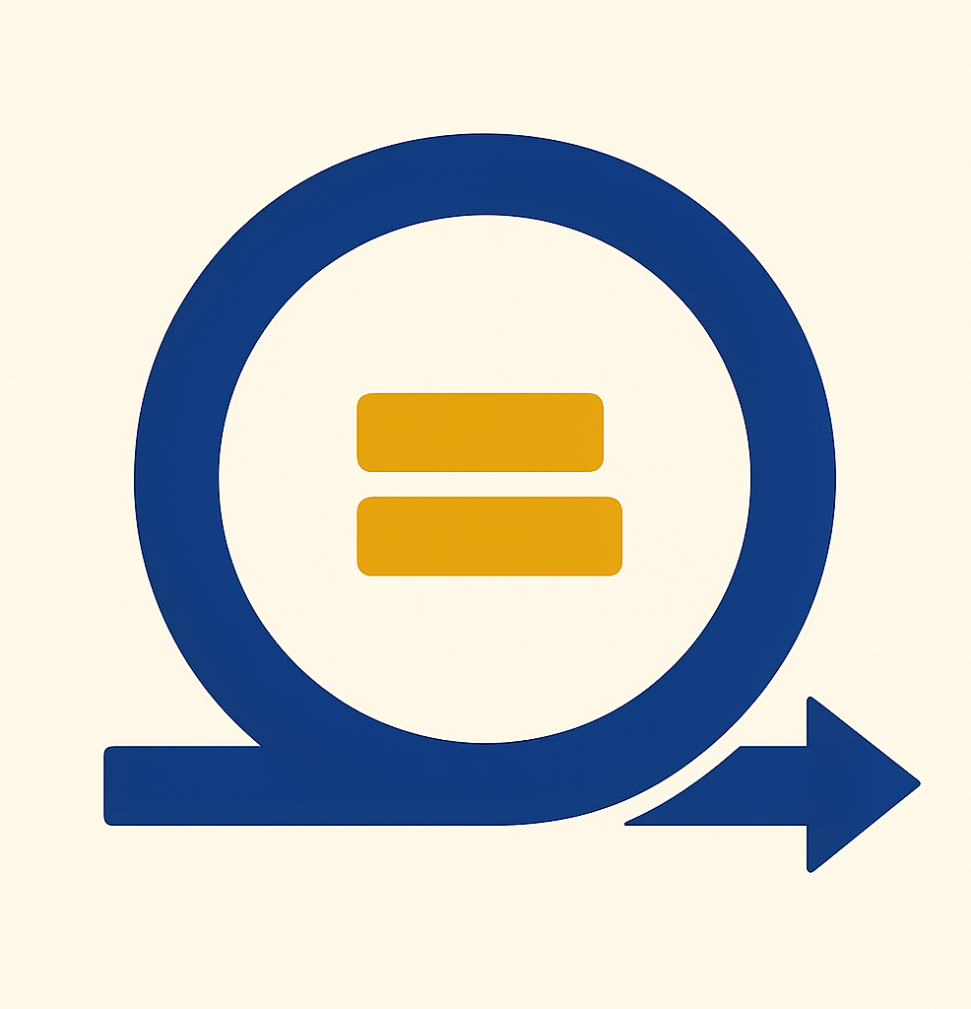

Agile Model – Key Characteristics
Iterative & incremental development
Focus on collaboration, early delivery, improvement
Short development cycles called sprints (1–4 weeks)
Adaptive planning and quick response to change
Cross-functional teams and strong communication
Based on Agile Manifesto values (e.g., working software > docs)
Notes:
Agile is a flexible way to build software. Instead of doing everything step by step like in Waterfall, Agile breaks work into small pieces called sprints.
Each sprint usually takes one to four weeks.
At the end of each sprint, the team shares working software and gets feedback.
The goal is to work closely with the customer and make changes as needed during the project—not just at the end.”

Slide 4
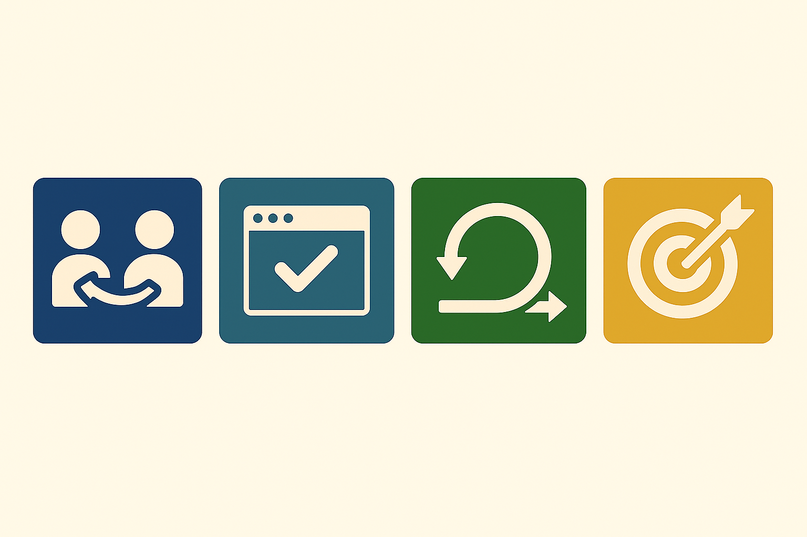
Agile – Strengths
High customer involvement and satisfaction
Rapid delivery of working software
Flexible to changing requirements
Encourages team collaboration and ownership
Continuous feedback and improvement
Notes:
“Agile has a lot of good points.
One, it keeps the customer involved the whole time, so they know what’s going on.
Two, working software is shown early and often, so people see progress fast.
Three, it’s easy to make changes if the customer wants something different.
Also, the team works together closely, which helps solve problems faster.
And with feedback every sprint, both the team and the product keep getting better.”

Slide 5
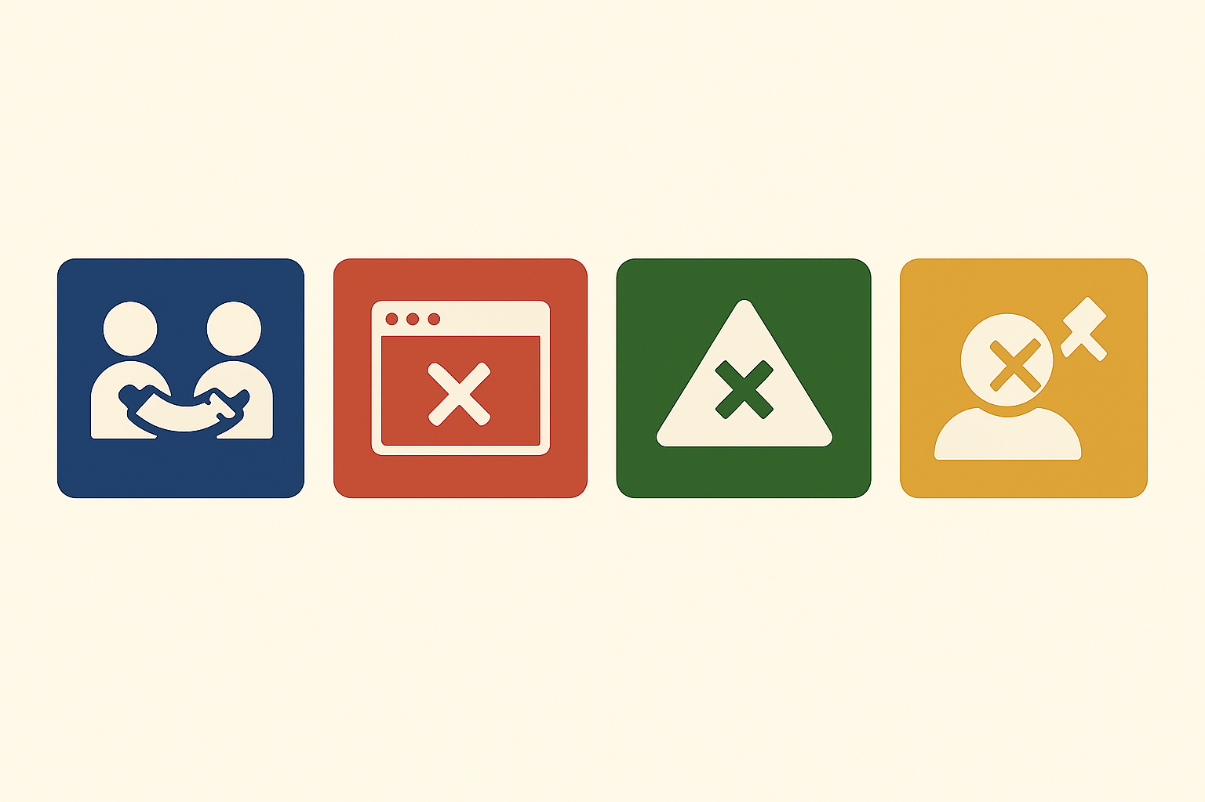
Agile – Disadvantages
Requires active and consistent customer participation
Difficult to scale for large, complex projects
Less emphasis on documentation
Can lead to scope creep without disciplined management
Notes:
“But Agile also has some downsides.
It needs the customer to be active and available throughout the project.
For big projects, Agile can be harder to manage without extra tools or structure.
Also, because the focus is on working software, sometimes the team doesn’t write enough documents.
And if the team isn’t careful, the project can go off track or take longer than planned.”

Slide 6
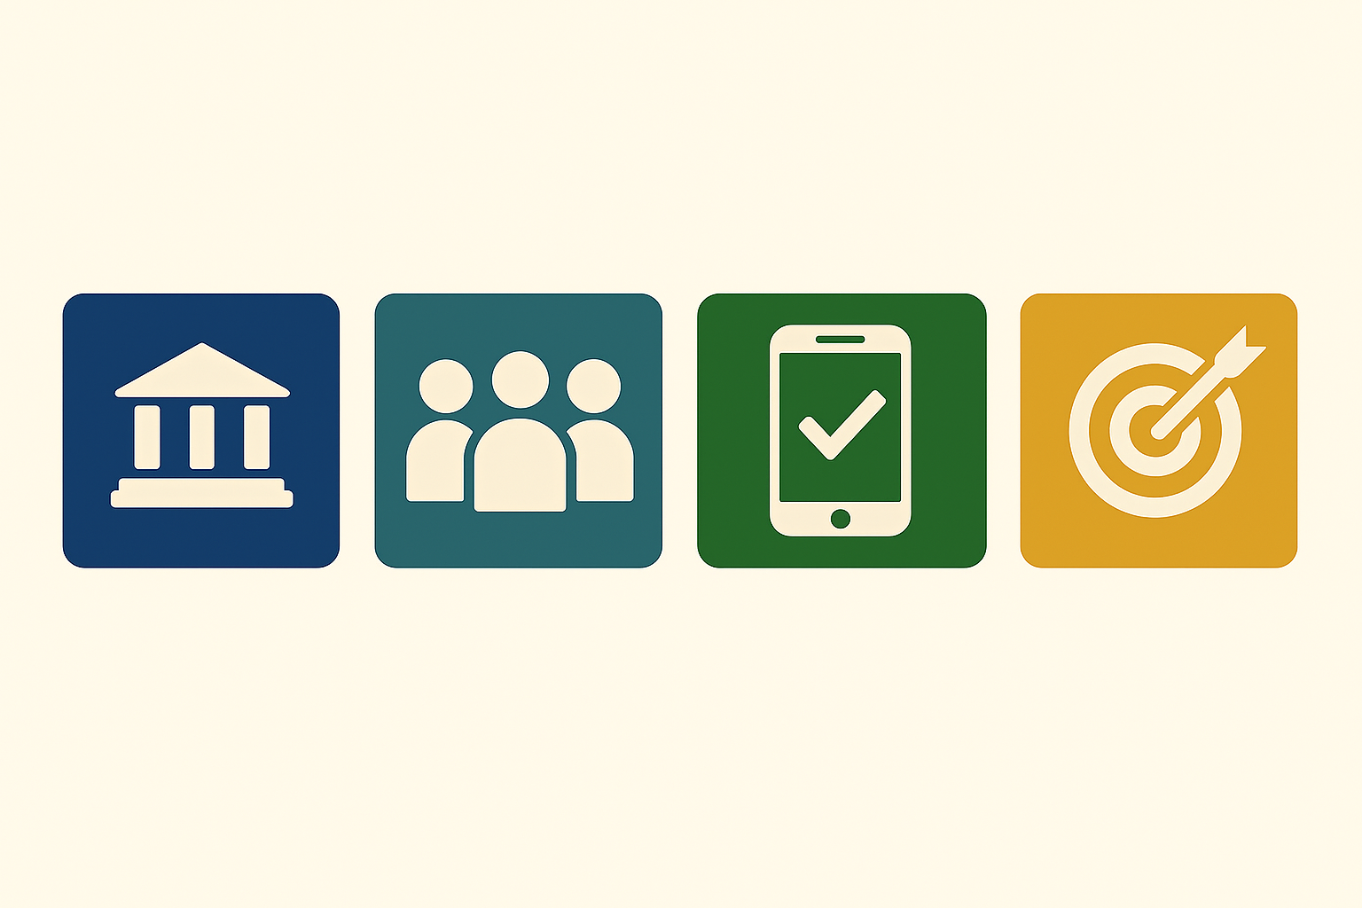
Agile – Best Use Case
Agile is best suited for:
- Projects with evolving requirements
- Small to medium-sized teams
- Startups and fast-paced product development
Example: Building a mobile app where frequent user feedback is crucial.
Notes:
“Agile works best when things are likely to change or when the team wants to move fast.
It’s a good choice for apps or websites, or any project where you want to test ideas quickly and get feedback.
Small and medium teams, especially in startups, use Agile a lot.
If you want to build something step by step and keep improving it, Agile is a great method.”
“Thanks for watching my Agile model presentation.
I hope this helped you understand how Agile works and when it’s a good fit.”

